Slide 1
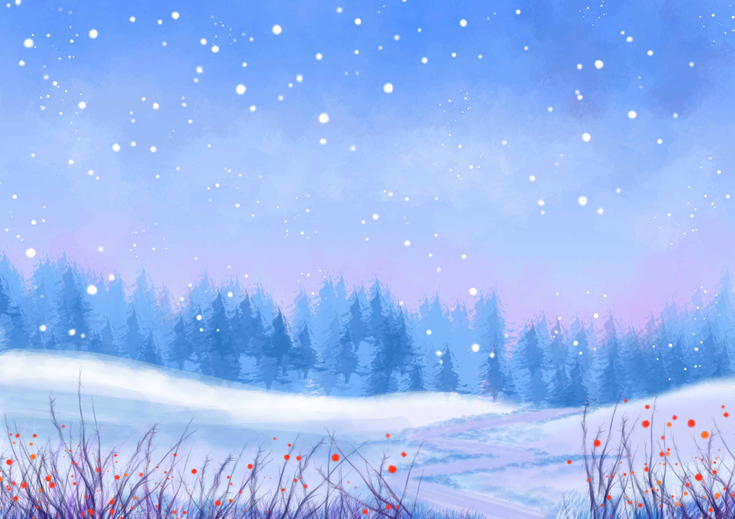
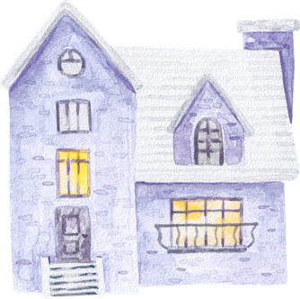

Young explorers
From screen to green learning
POLAND

Slide 2

Walk to nature....
In winter, when access to fresh vegetation is limited, they must rely on other food sources. Beech seeds, tree bark, and pine cones play an important role.
Our little explorers had the opportunity to see the animals' diet and observe how nature changes as winter approaches.

Slide 3
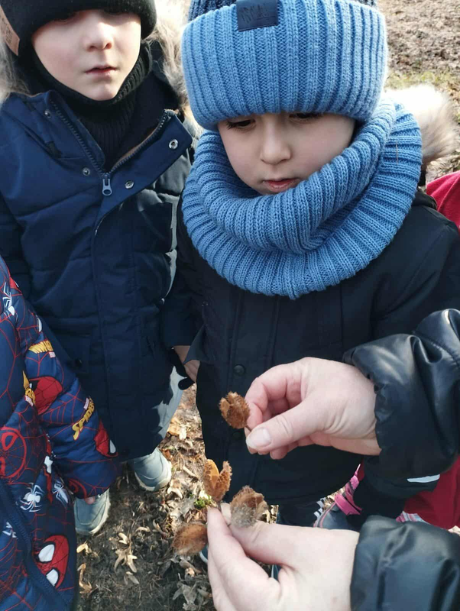
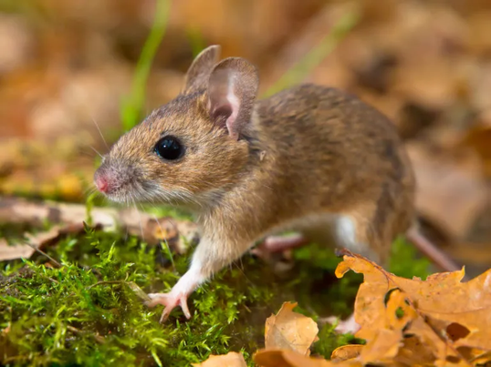
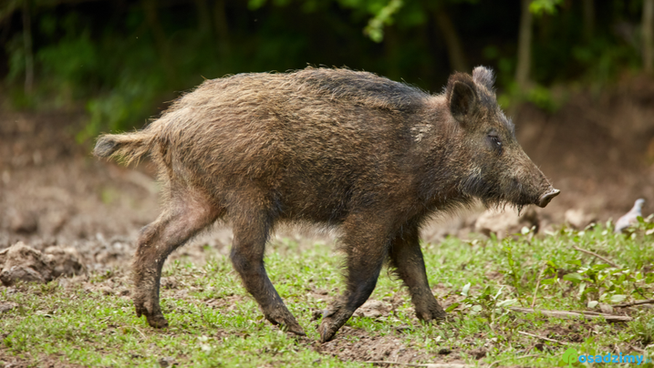
Beech seeds are a valuable food rich in fat and protein. They are eaten by wild boars, wood mice, and birds, helping animals survive the winter.

Slide 4
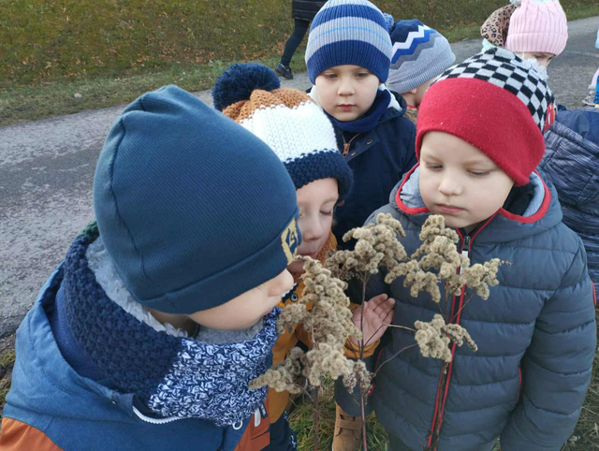
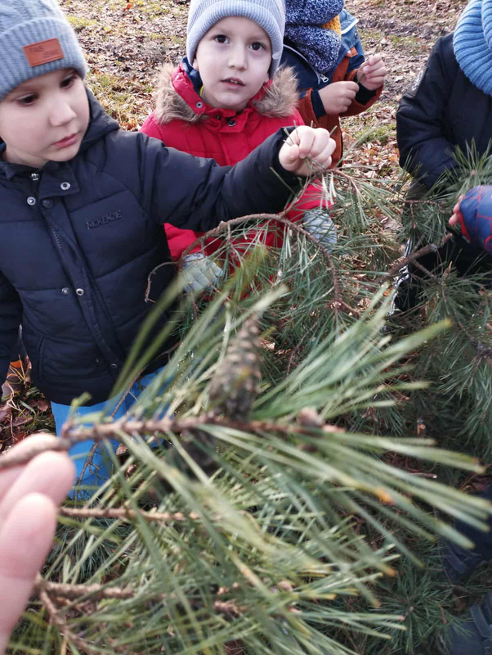
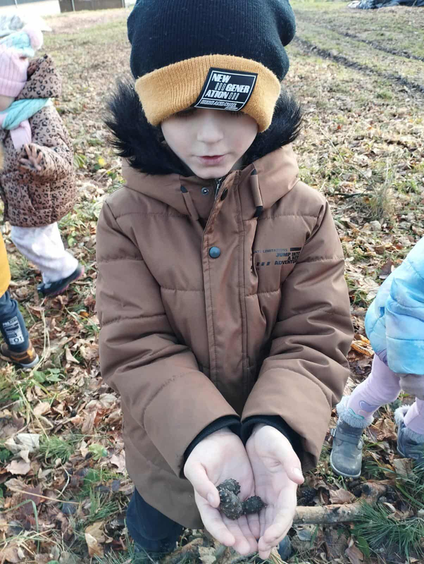
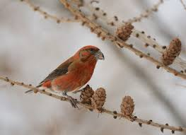
The cones of coniferous trees such as pine and spruce contain seeds that are eagerly eaten by birds (e.g. crossbills) and rodents.

Slide 5
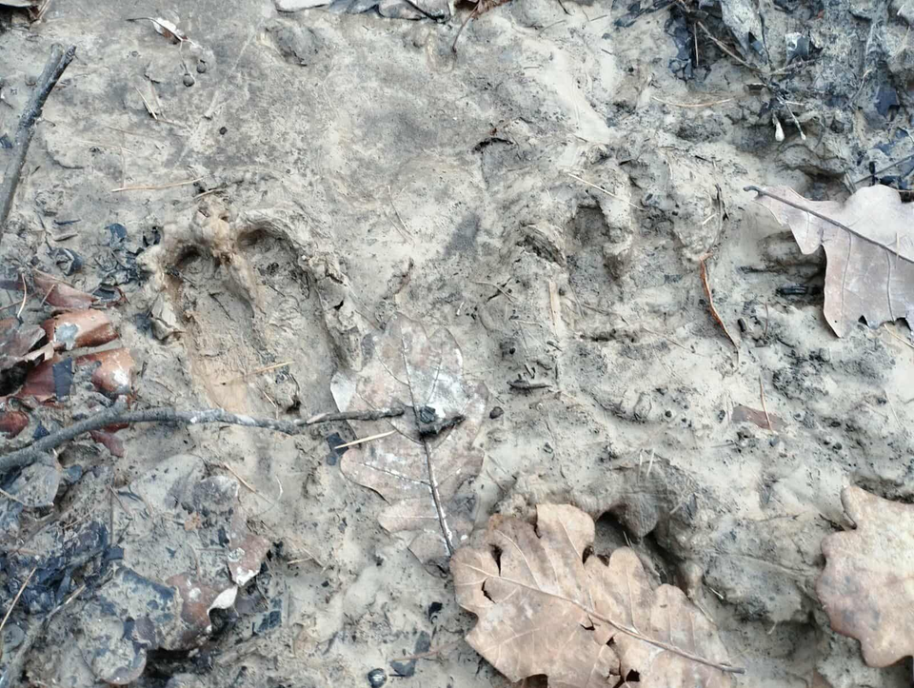
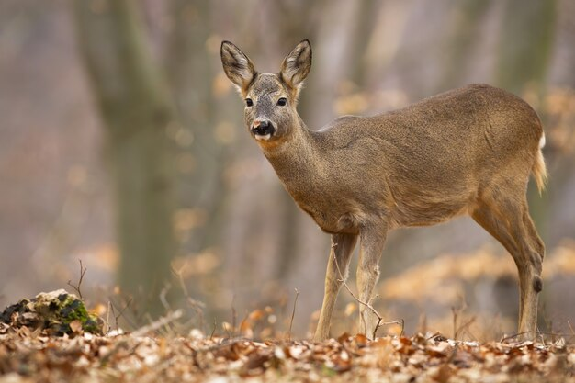
The children also spotted traces of deer, which will not hide for the winter.

Slide 6
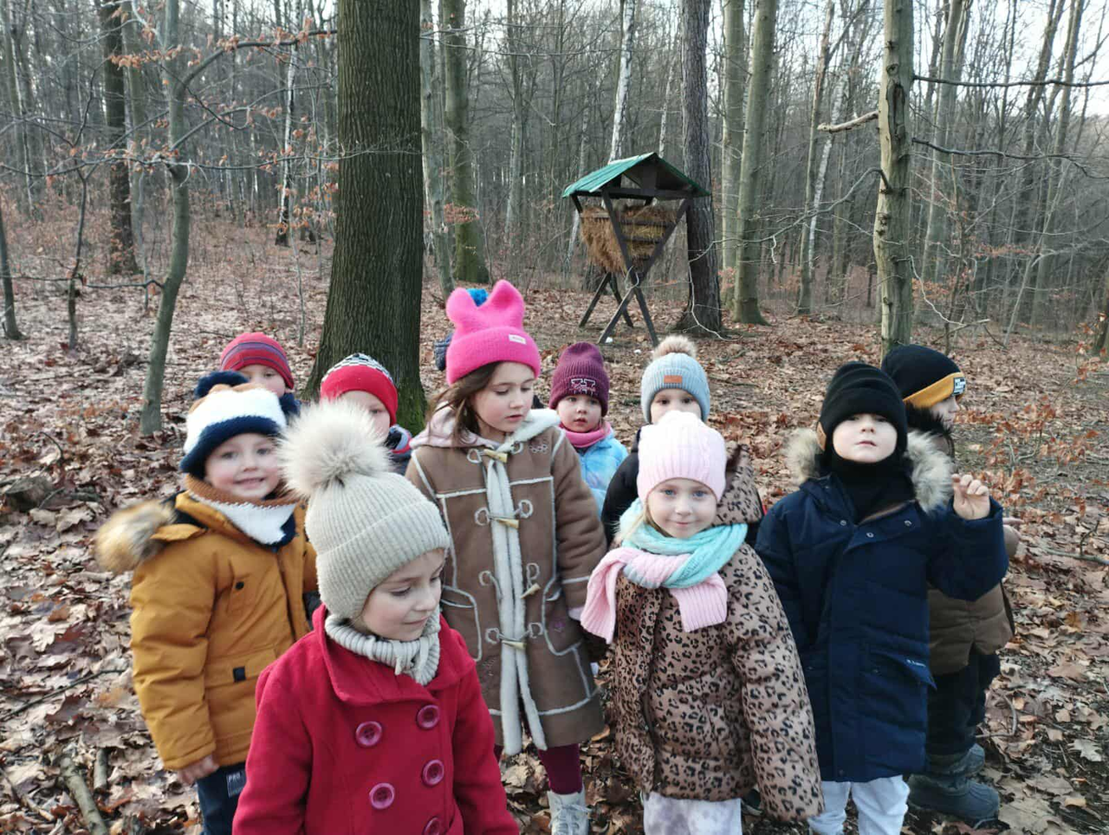
They also reached the very center of the forest and the pasture, where the forester feeds the roe deer and deer.

Slide 7
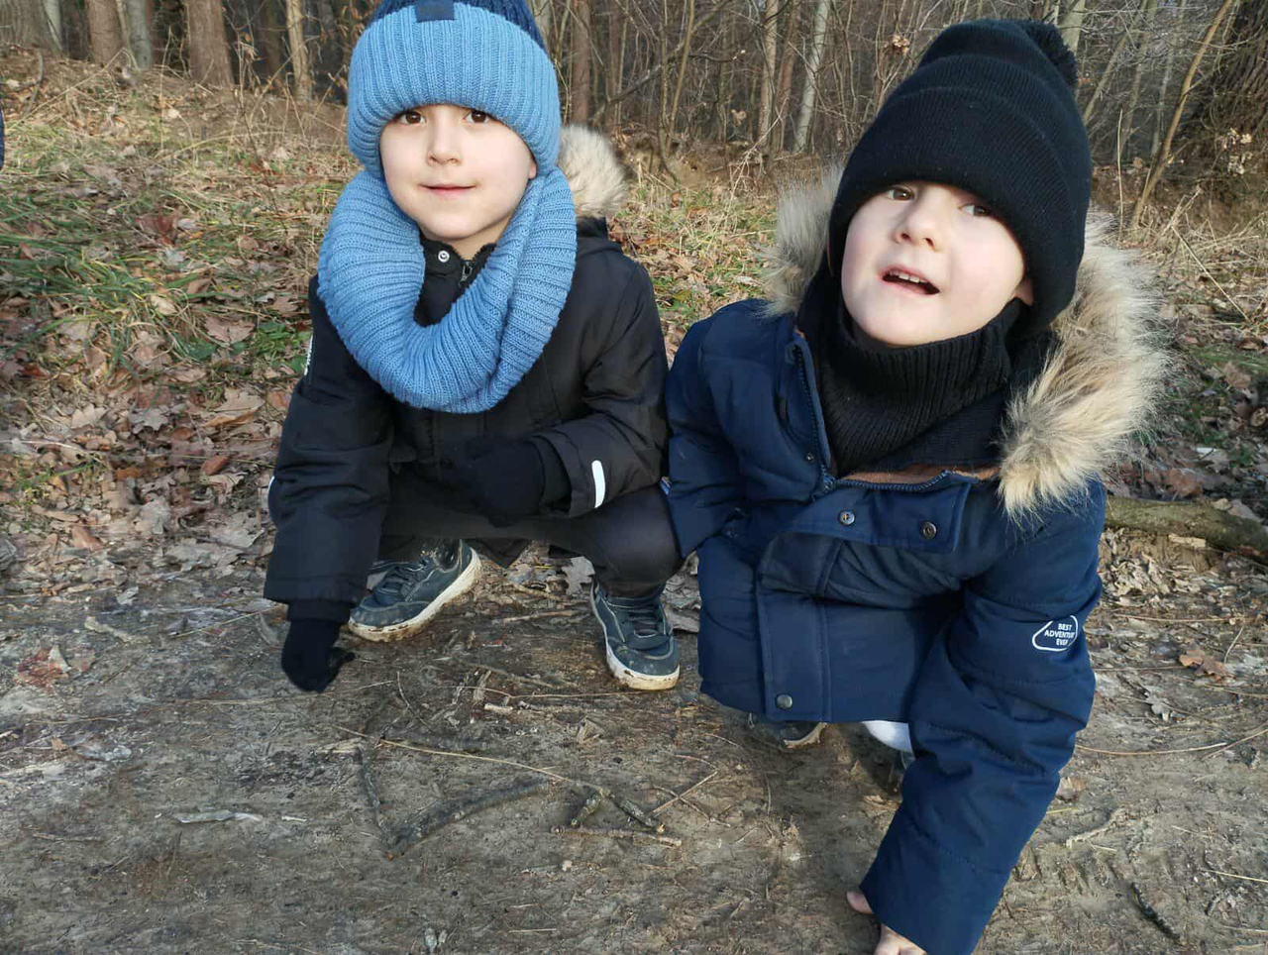
Little learn geometrick..
While observing the soil, they remembered geometric figures and used branches for this purpose.

Slide 8
Thank You

