Slide 1


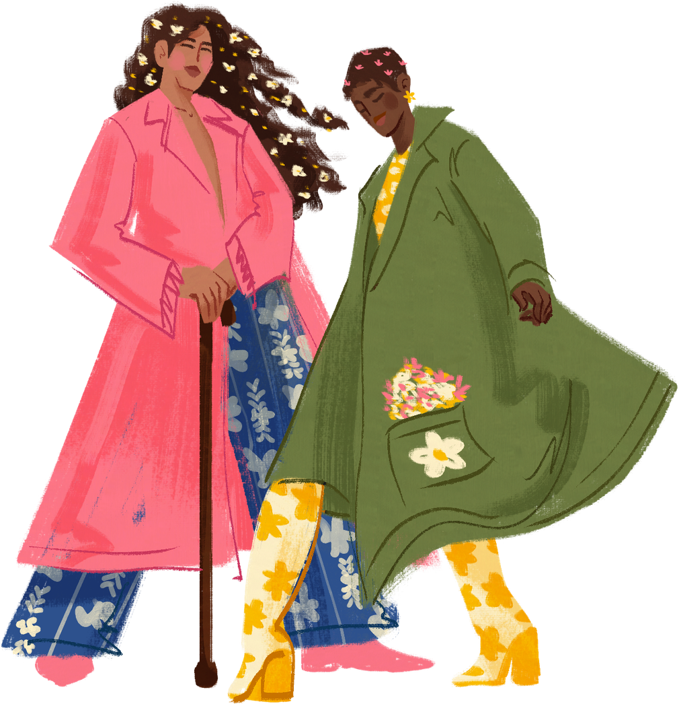



Eco-Fashion Show
POLAND

Slide 2



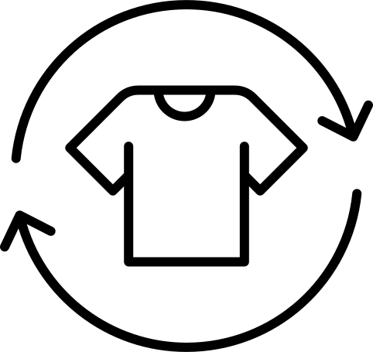
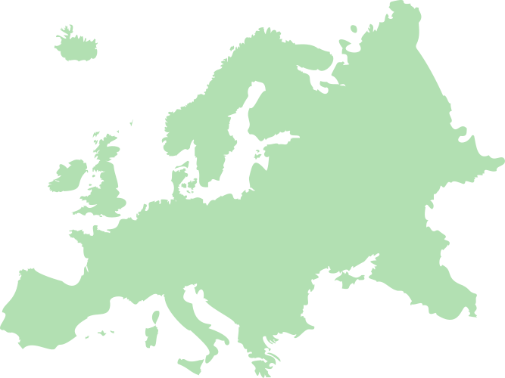


FIRST STEP
WORK WITH PARENTS
MAIN GOAL: SUPPORT THE CHILD IN CREATING A PRESENTATION OR OUTFIT USING RECYCLED MATERIALS, WHILE BUILDING ENVIRONMENTAL AWARENESS AT HOME.

Slide 3







Areas of cooperation
Jointly establish the theme of "Recycled Eco-Fashion."
The parent helps translate the child's imagination into a realistic implementation plan.
Resource collection: Together, we sort household waste that can become "plastic" (bottle caps, milk cartons, old newspapers, foil, cans).
Joint crafting:
Child: Designs, paints, decorates, and assembles lighter elements.
Parent: Operates more difficult tools (wallpaper cutter, hot glue gun), ensuring the safety and durability of the structure.

Slide 4


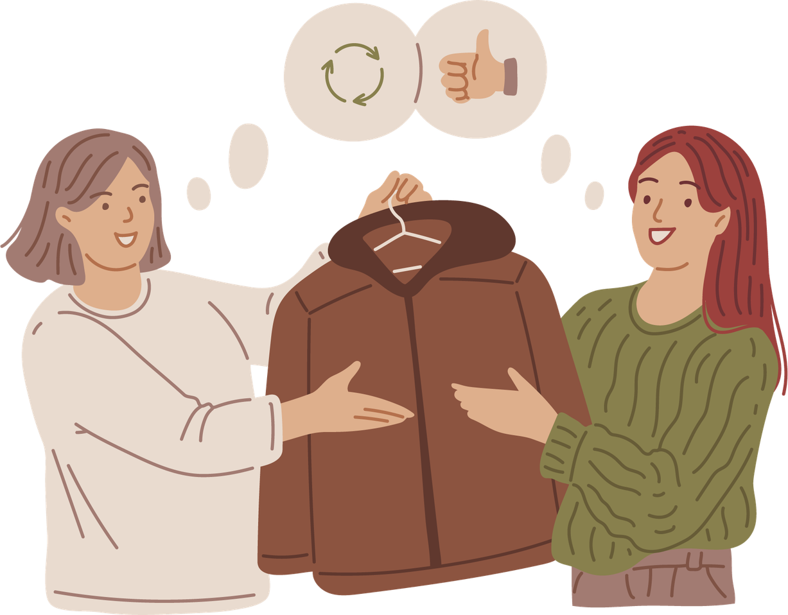

FINAL PROJECT
EKO-FASION SHOW

Slide 5



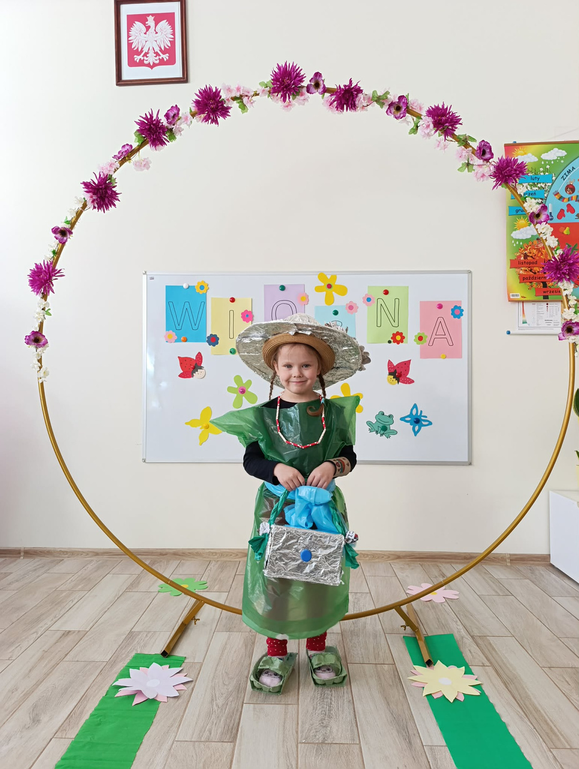
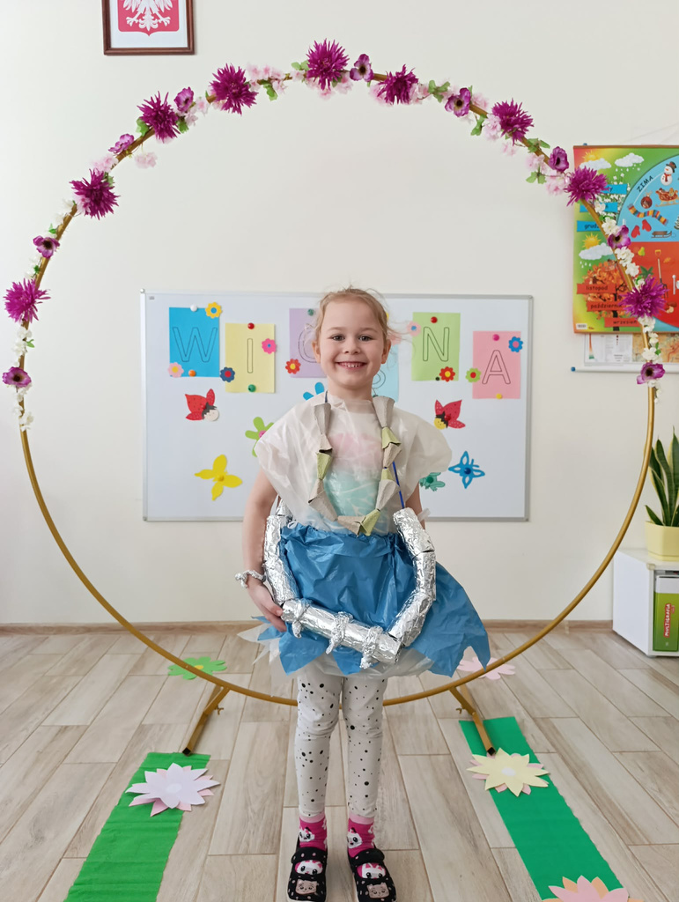

EKO - FASHION

Slide 6

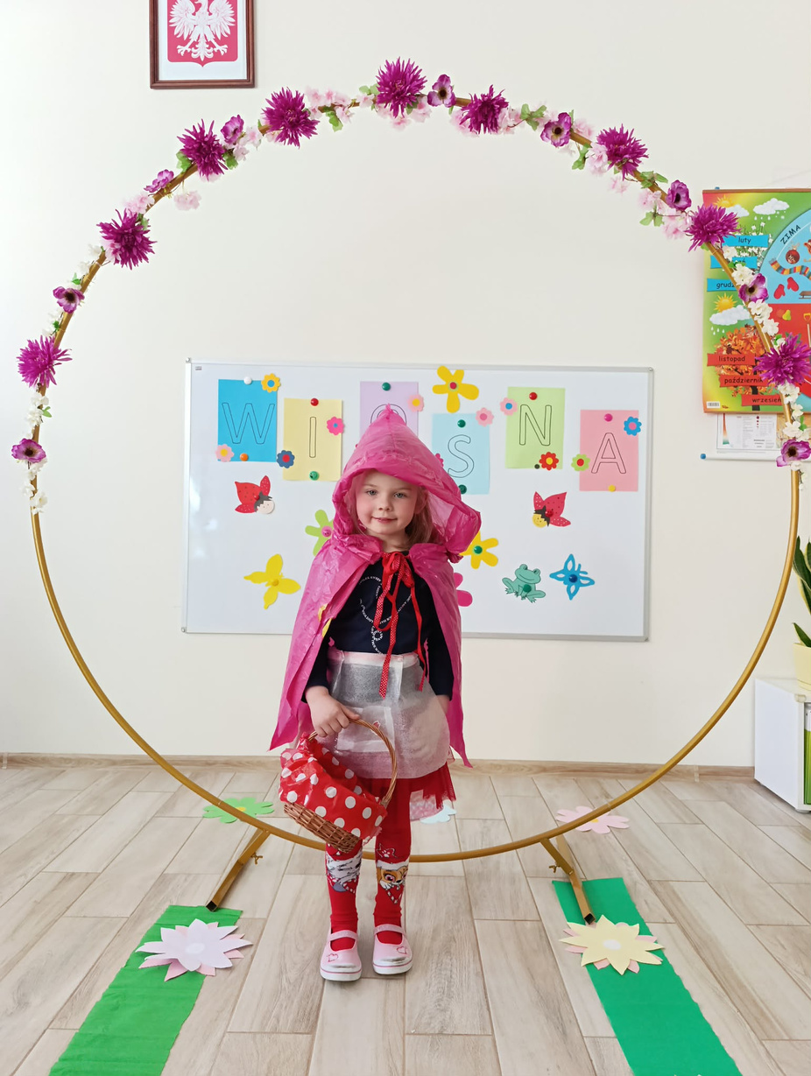
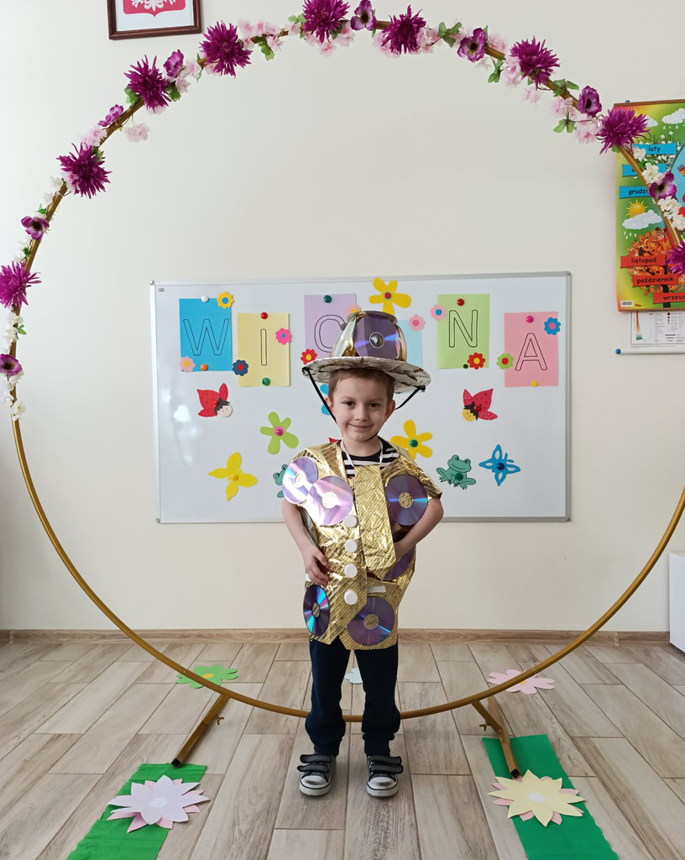


Slide 7


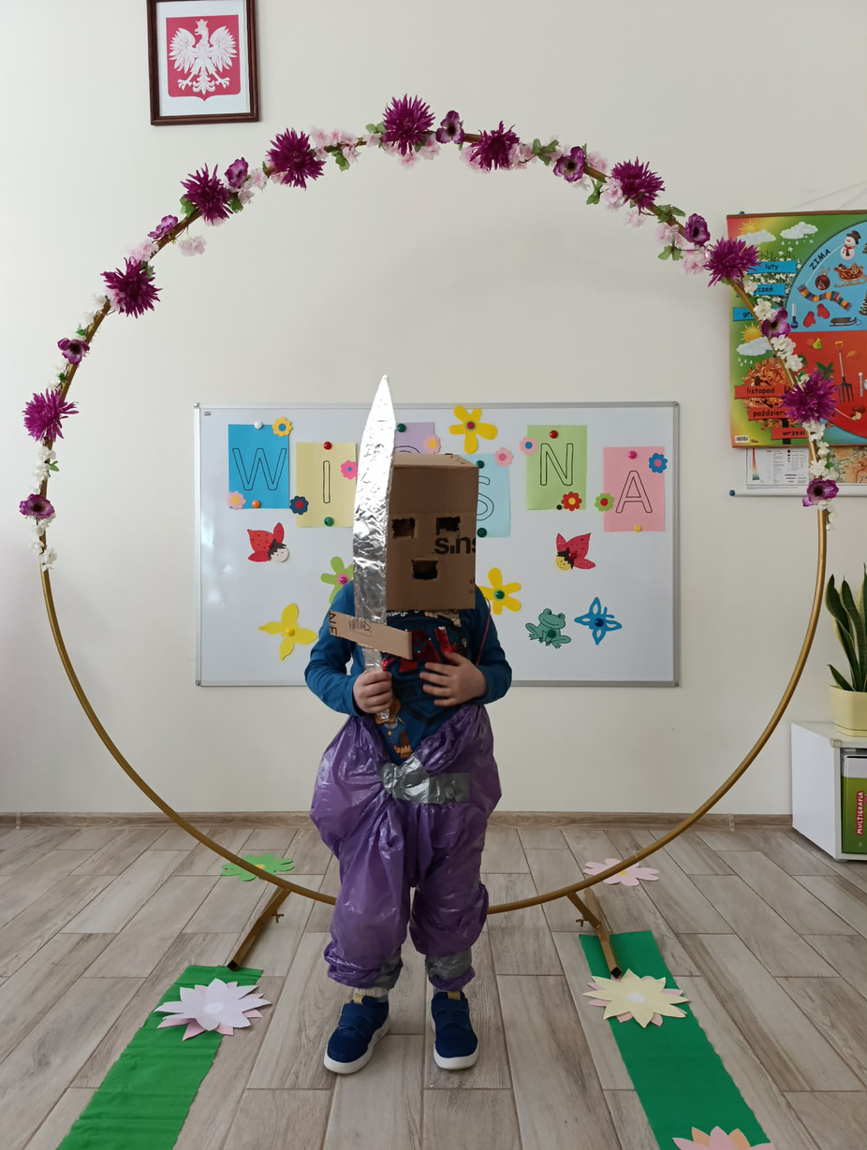
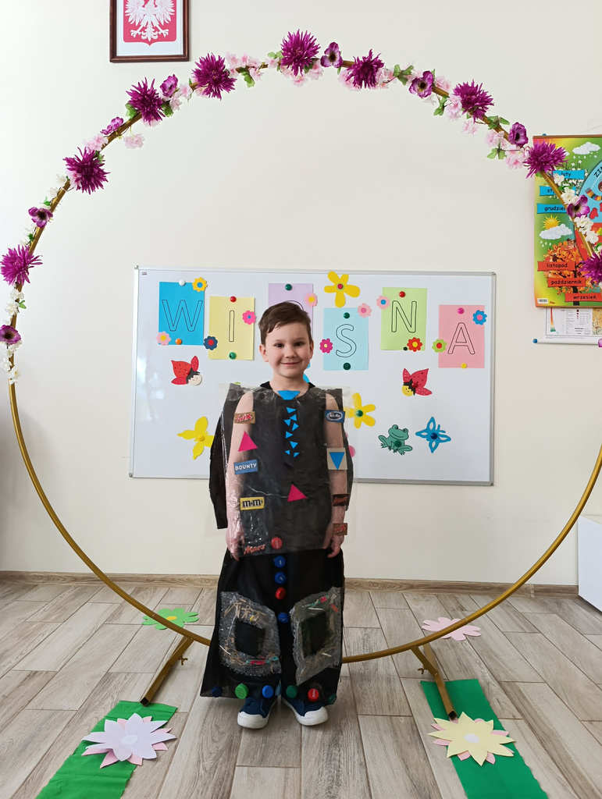


Slide 8


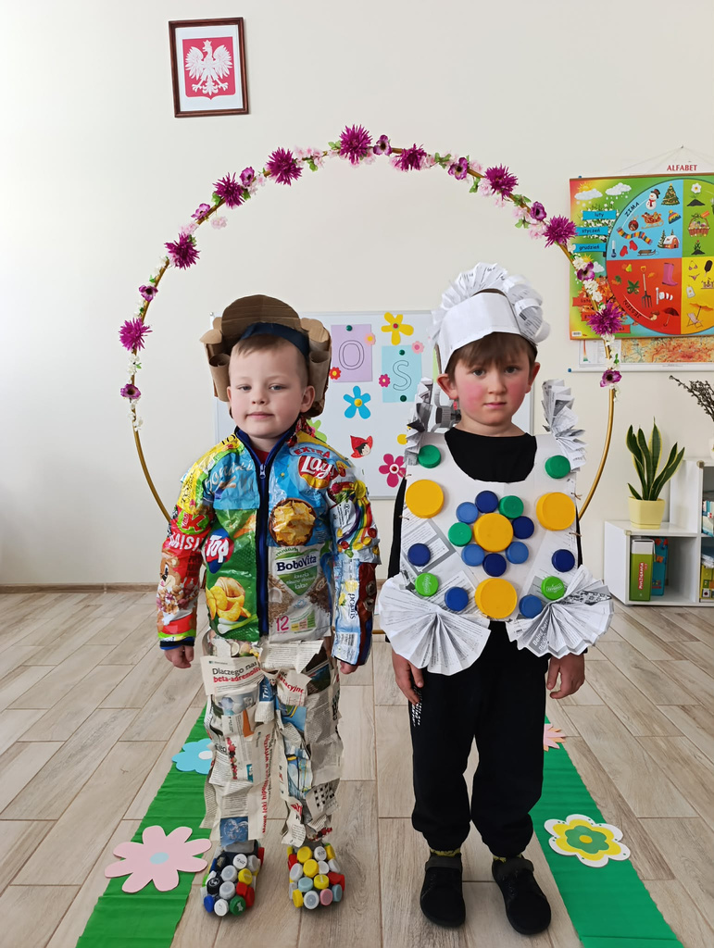
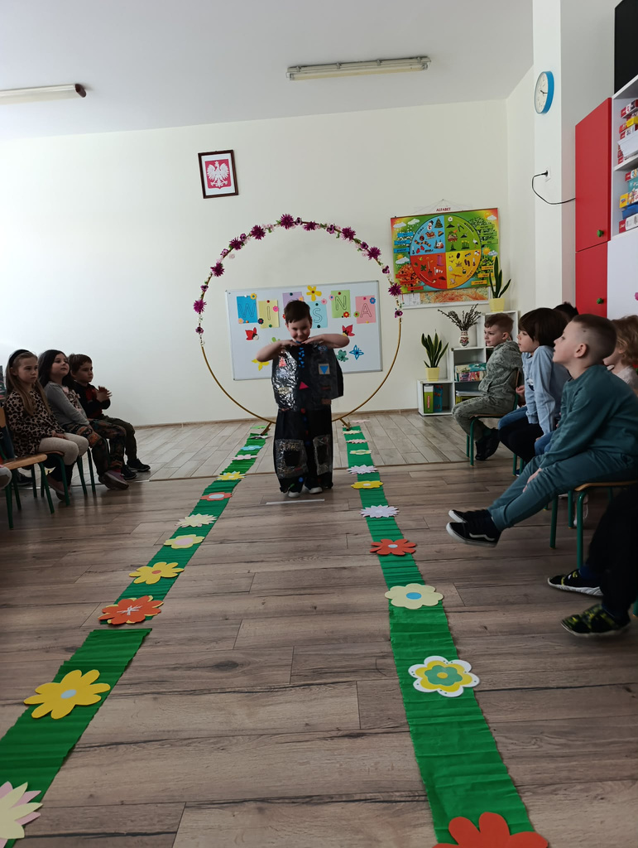



Slide 9
