Slide 1

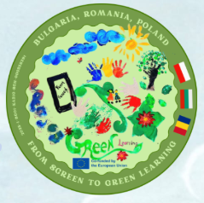

INTERNATIONAL DAY OF FOREST
Earth Day
FROM SCREEN TO GREEN LEARNING
ERASMUS+ KA210-SCH Project № 2025-1-BG01-KA210-SCH-00035829
POLAND

Slide 2

SMALL HANDS – BIG DEAL: PRESCHOOLERS PLANT A TREE TO CARE FOR THE ENVIRONMENT.
AS PART OF THE CAMPAIGN, THE CHILDREN PLANTED A WILLOW (IWE) (AN EXTREMELY IMPORTANT, HONEY-PRODUCING, EARLY SPRING PLANT THAT PROVIDES A VALUABLE FOOD SOURCE FOR BEES AND OTHER POLLINATING INSECTS).
DURING ACTIVITIES PRECEDING THE PLANTING, THE CHILDREN LEARNED ABOUT THE IMMENSE IMPORTANCE OF TREES FOR ANIMALS AND PEOPLE, AS A HABITAT, SHELTER, AND SOURCE OF CLEAN AIR. WE ALSO DISCUSSED HOW FORESTS PROVIDE A SPACE FOR REST AND RECREATION, AND CAN ALSO PROVIDE PEOPLE WITH ADDITIONAL FOOD, SUCH AS FOREST FRUITS AND MUSHROOMS.
WE ALSO TOUCHED ON ECOLOGY AND HOW EACH OF US, FROM A YOUNG AGE, CAN CARE FOR THE NATURAL ENVIRONMENT.
THE TREE WAS PLANTED IN FRONT OF THE SCHOOL, AND WE HOPE IT WILL GROW ALONGSIDE OUR PRESCHOOLERS, REMINDING THEM TO CARE FOR NATURE EVERY DAY.

Slide 3
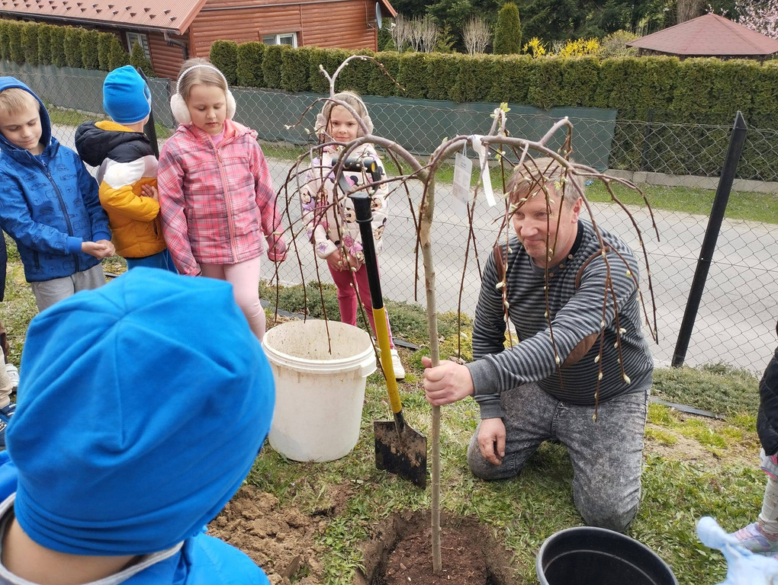
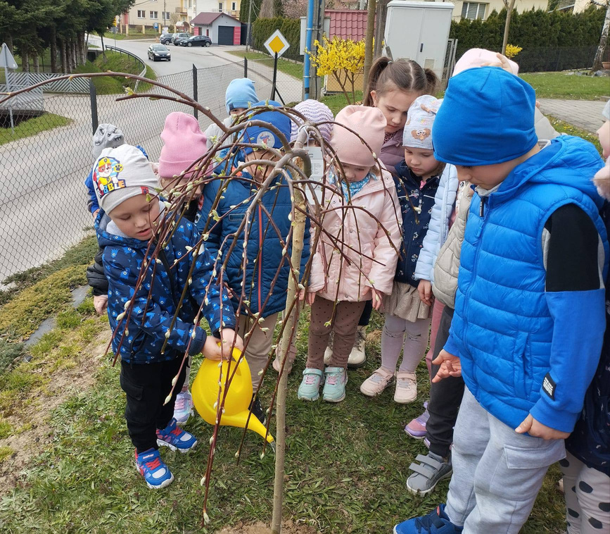
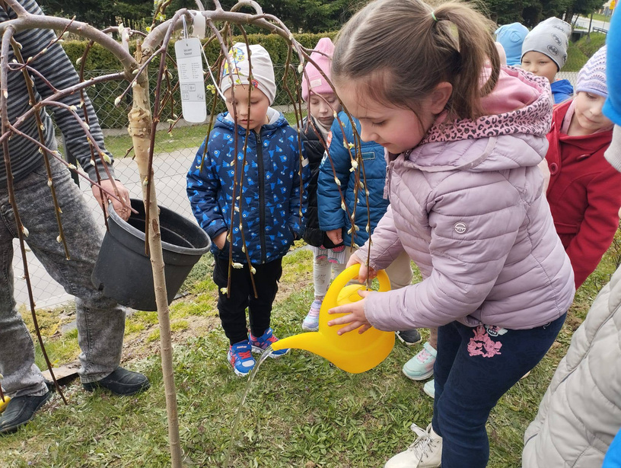

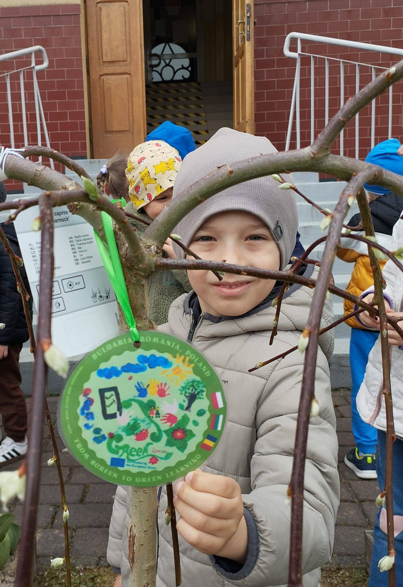
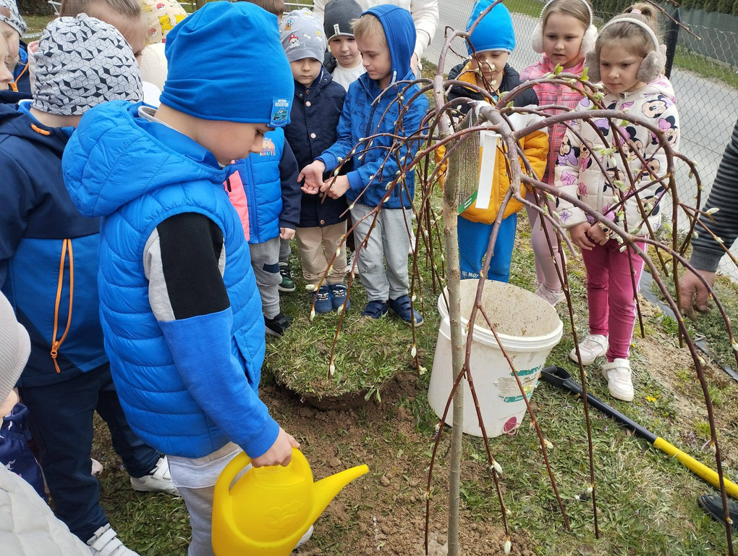

Slide 4
FOREST LESSON FOR PRESCHOOLERS
THE CHILDREN PARTICIPATED IN A UNIQUE LESSON HELD IN A NEARBY FOREST. IT WAS AN INCREDIBLY ENGAGING ENCOUNTER WITH NATURE, DURING WHICH A FORESTER FASCINATINGLY INTRODUCED THE CHILDREN TO THE SECRETS OF THE FOREST WORLD.
THE PRESCHOOLERS LEARNED ABOUT THE LAYERS OF THE FOREST AND WHO LIVES IN EACH LAYER. THEY ALSO DISCUSSED THE TYPES OF FORESTS, TREE SPECIES, AND FOREST INHABITANTS – BOTH LARGE AND SMALL. THE CHILDREN ALSO LISTENED WITH INTEREST TO STORIES ABOUT WOOD AND ITS IMPORTANCE IN THE DAILY LIVES OF HUMANS AND ANIMALS.
UPON RETURNING TO SCHOOL, A SURPRISE AWAITED THE PRESCHOOLERS. EACH RECEIVED A PUZZLE FEATURING FOREST INHABITANTS, WHICH, WHEN COMPLETED, TEACHES CHILDREN CONCENTRATION AND PATIENCE.

Slide 5
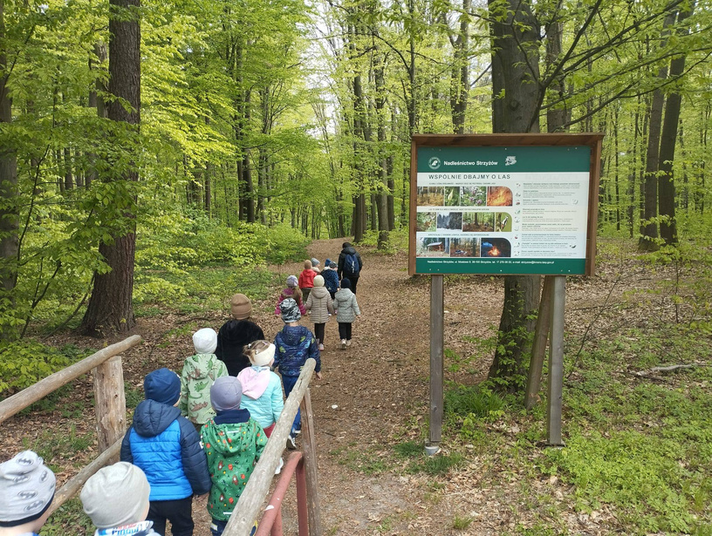
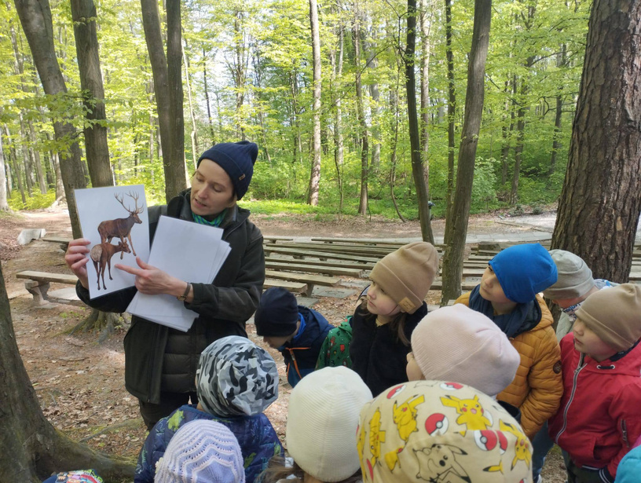
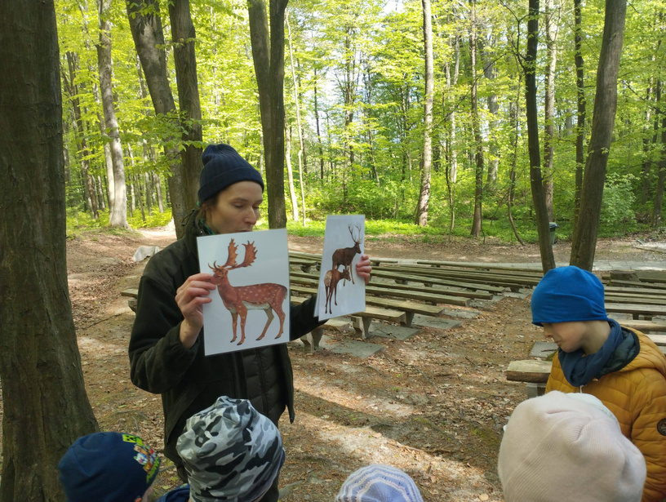

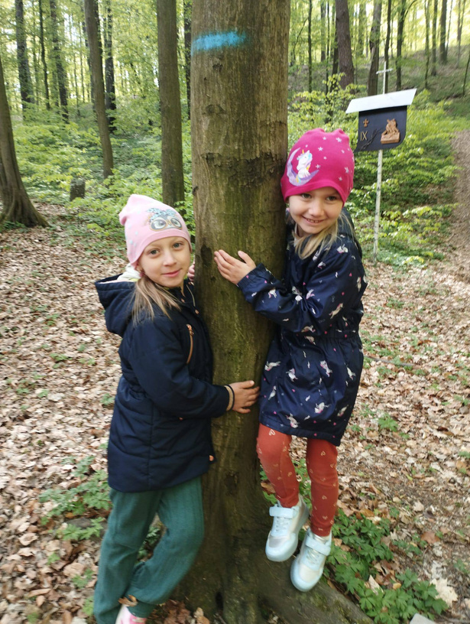
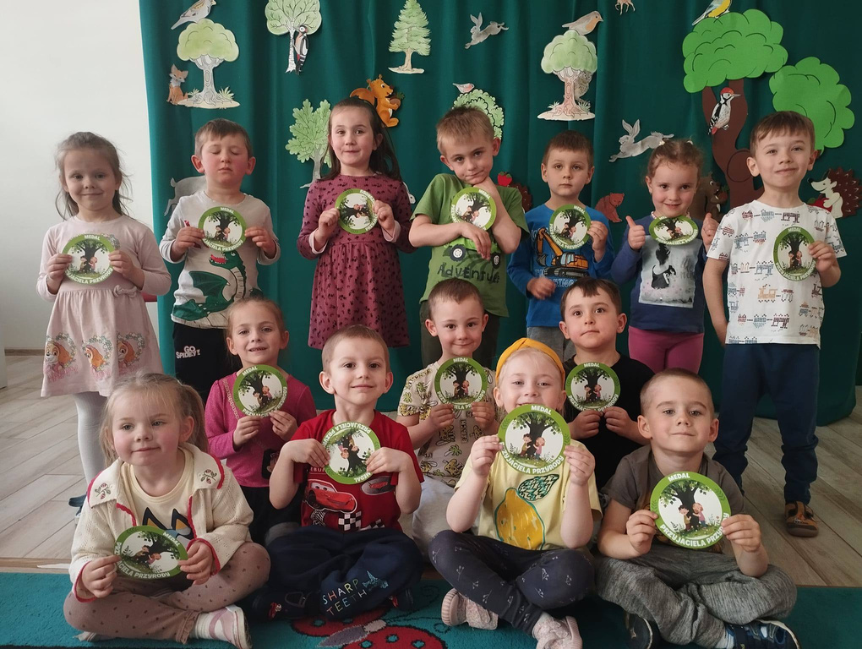

Slide 6

EARTH DAY
ON APRIL 22ND, WE CELEBRATED EARTH DAY AT OUR PRESCHOOL!
DURING THE CELEBRATION, WE DISCUSSED THE IMPORTANT ROLE FORESTS PLAY IN OUR PLANET – WHY THEY ARE SO VALUABLE AND HOW WE CAN CARE FOR THEM. WE ALSO HAD A LOT OF FUN! THE CHILDREN PARTICIPATED IN A GAME OF GUESSING THE SOUNDS OF FOREST ANIMALS AND IMITATED THEIR MOVEMENTS, WHICH BROUGHT US LOTS OF JOY AND LAUGHTER. IN THE ART SECTION, THE SIX-YEAR-OLDS CREATED A PROJECT TITLED "FOREST IN A JAR," RESULTING IN SMALL WORKS OF ART INSPIRED BY THE FOREST ENVIRONMENT.

Slide 7
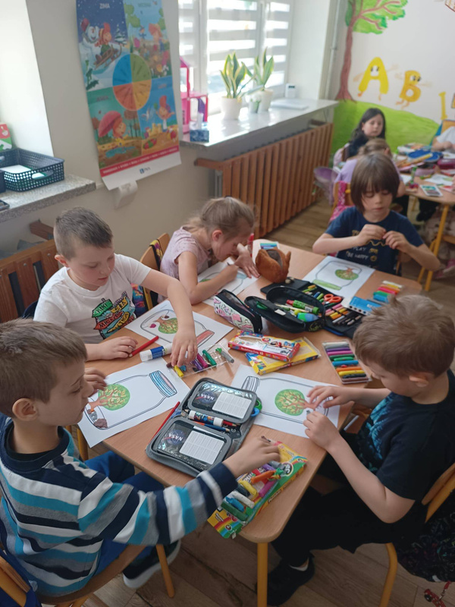
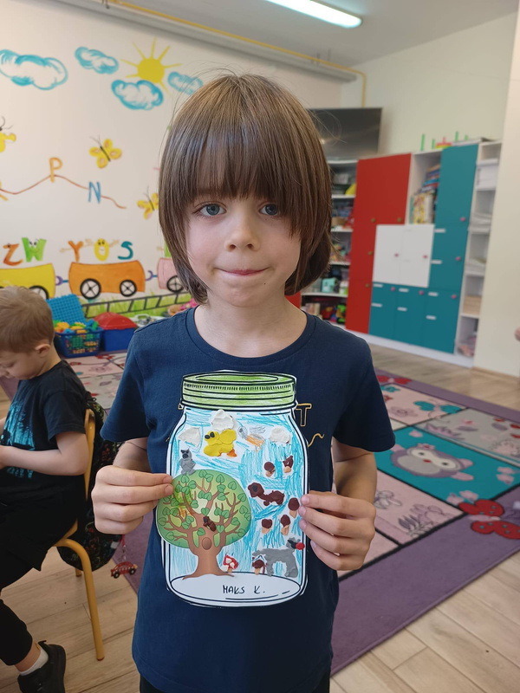



Slide 8
THANK YOU

