Slide 1

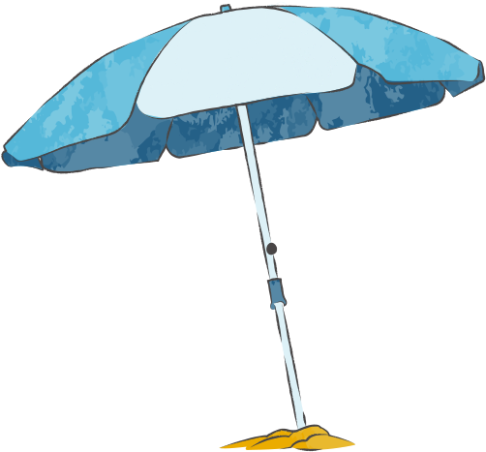

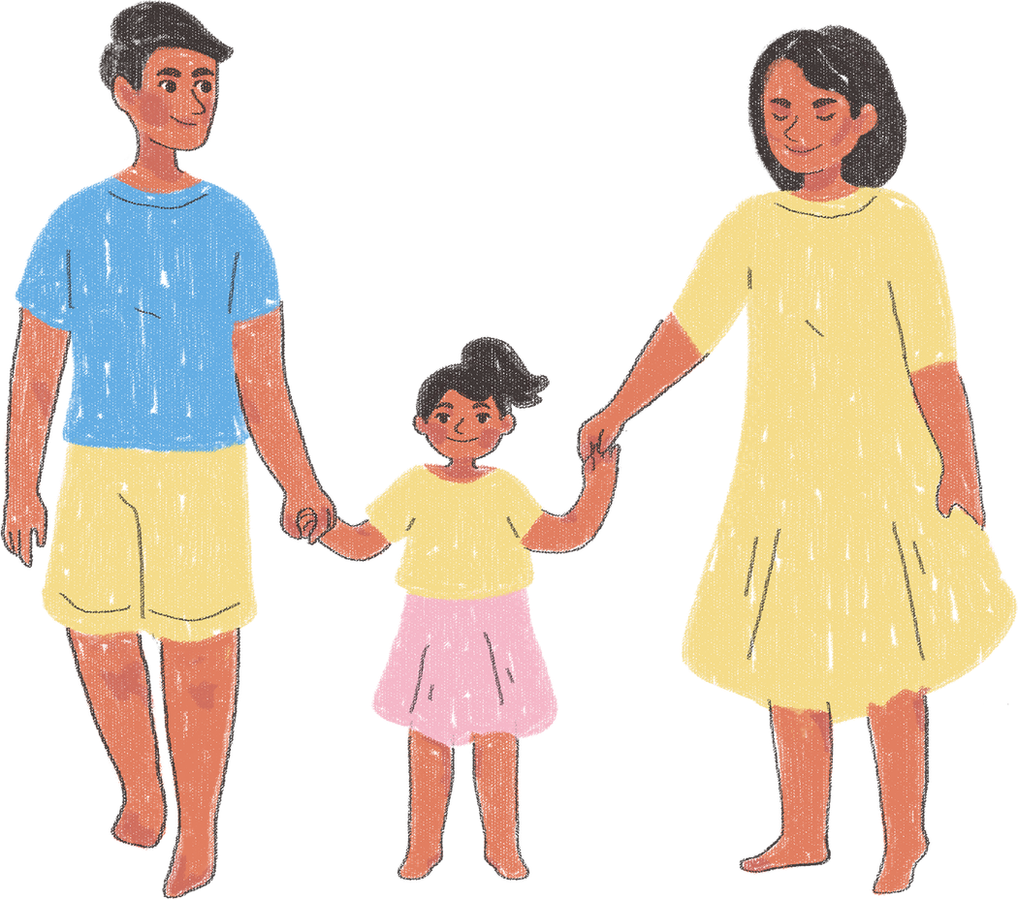
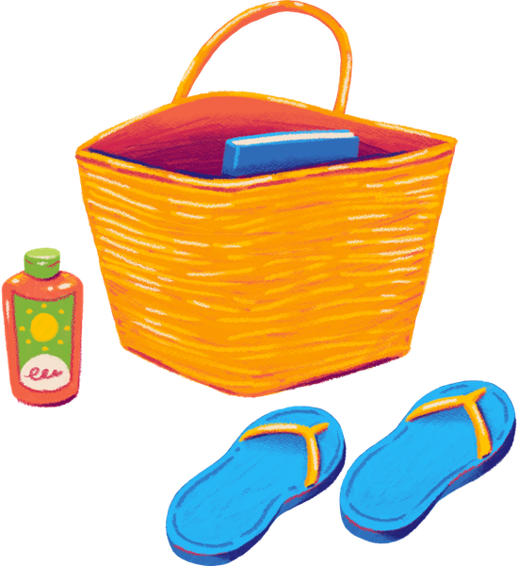

FAMILLY DAY
Hiking/outdoor sports games with parents
FROM SCREEN TO GREEN LEARNING

Slide 2

AS PART OF THE FROM SCREEN TO GREEN LEARNING PROJECT, A HAWAIIAN-STYLE FAMILY PICNIC WAS ORGANIZED.

Slide 3

TIME WITH OUR PARENTS

Slide 4
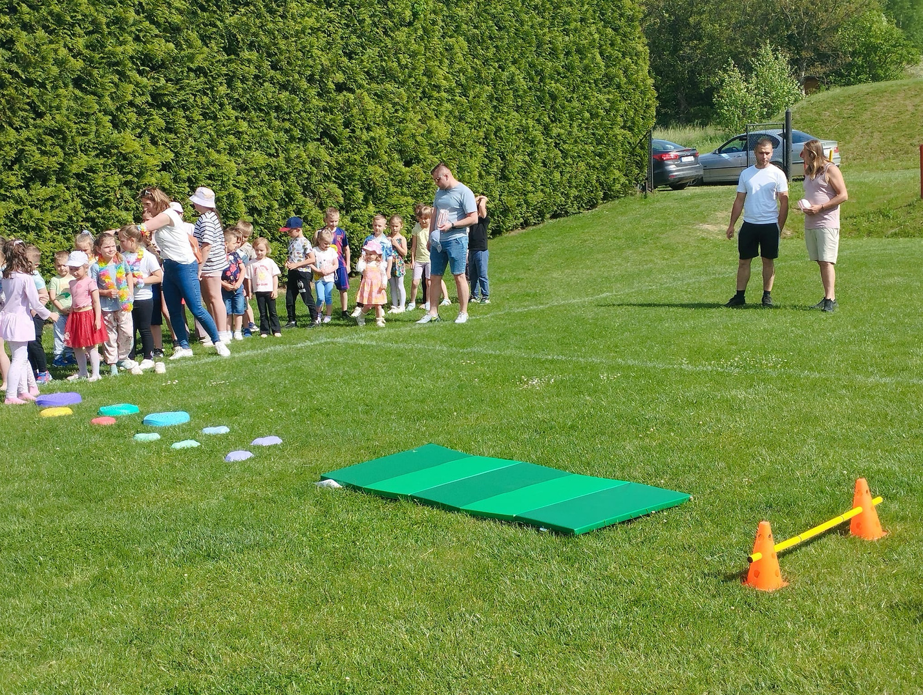

Slide 5
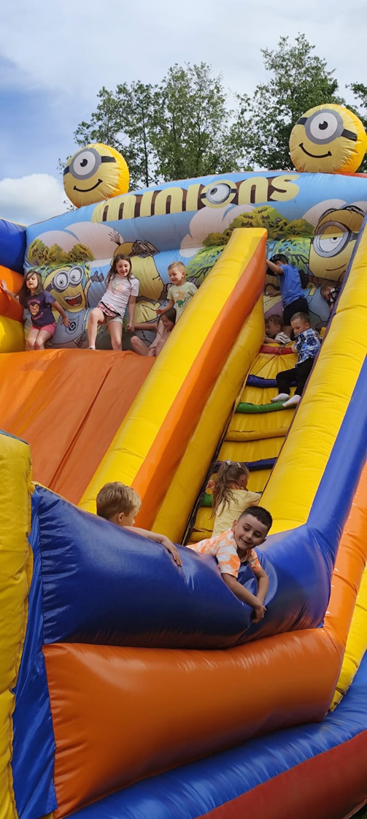
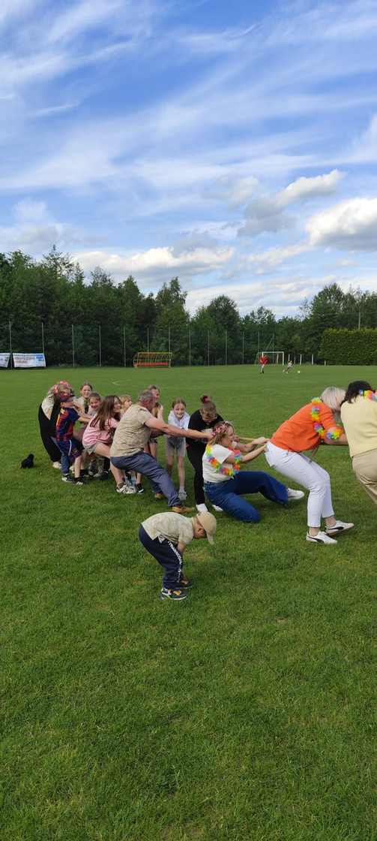
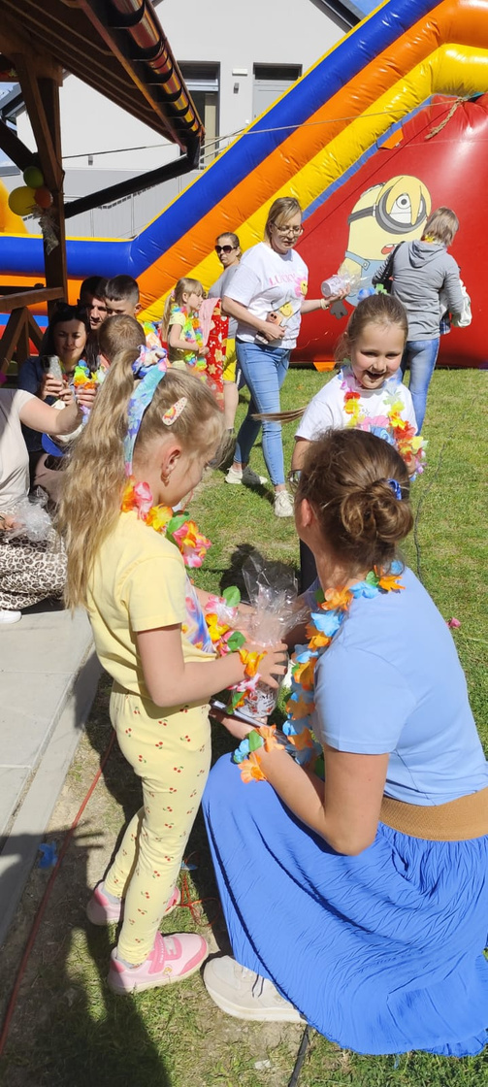



Slide 6
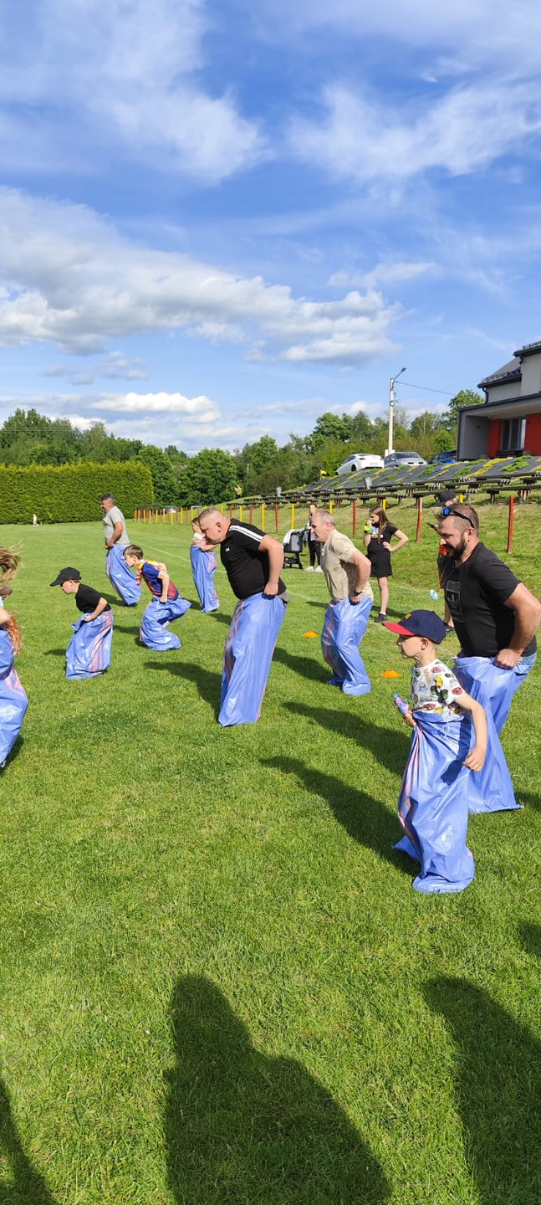
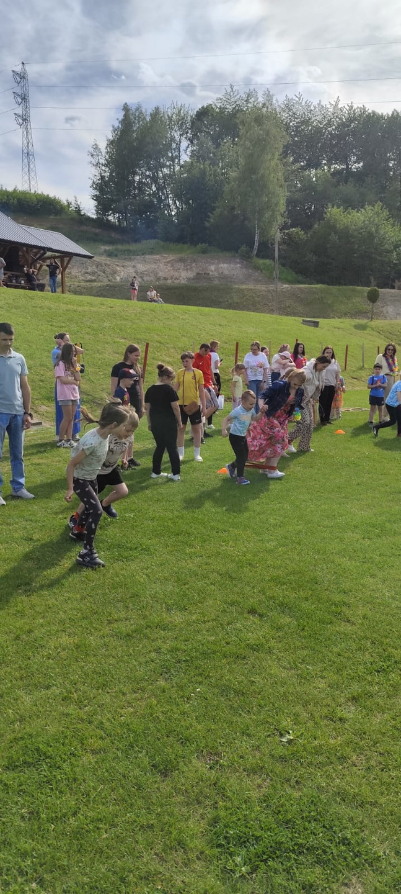

Slide 7
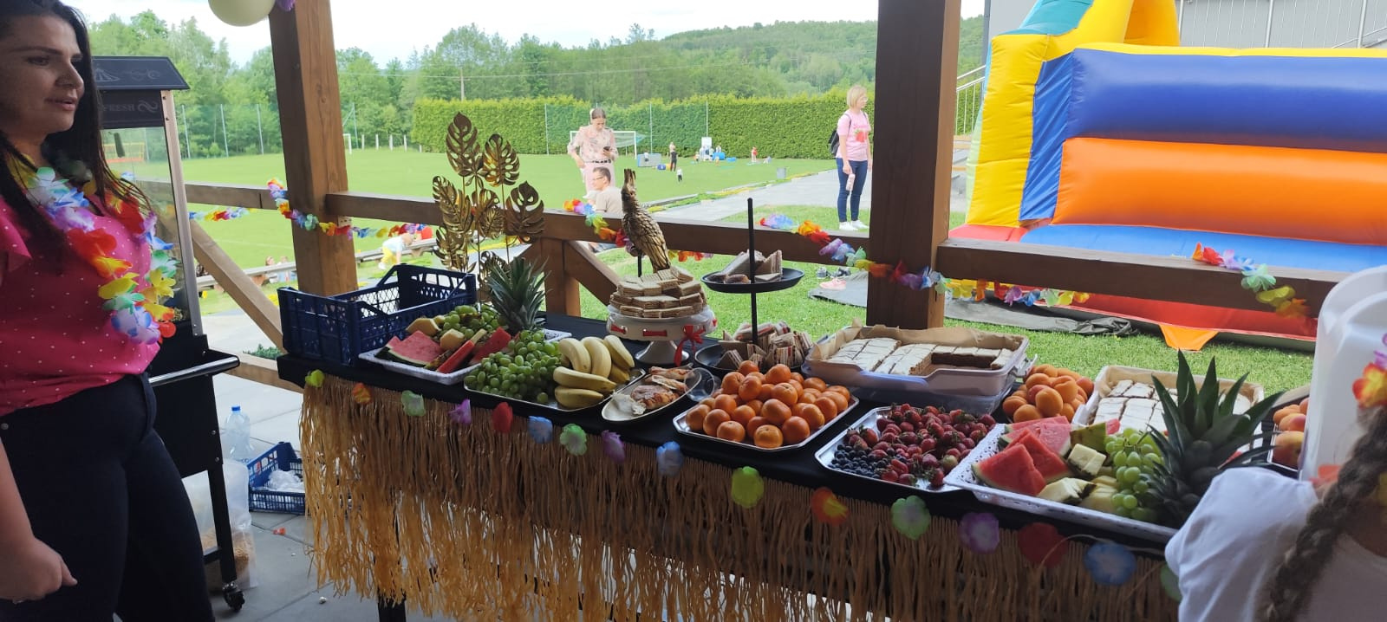


Slide 8
LINK TO THE VIDEO
HTTPS://WWW.YOUTUBE.COM/SHORTS/GECZPKULVJ8

Slide 9
THANK YOU

